Slide 1
Unconstrained
Optimization
Image Adhikari & Gobinda Pandey

Slide 2
Function 1: Quadratic Function
Gradient Descent
Steps: 85, Minimum f(x): 0.025517836989300404
Newton’s Method
Steps: 1, Minimum f(x): 0.0
Quasi-Newton (BFGS)
Steps: 73, Minimum f(x): 0.012437960354649402
Adam Optimizer
Steps: 3247, Minimum f(x): 0.026126965235065427

Slide 3
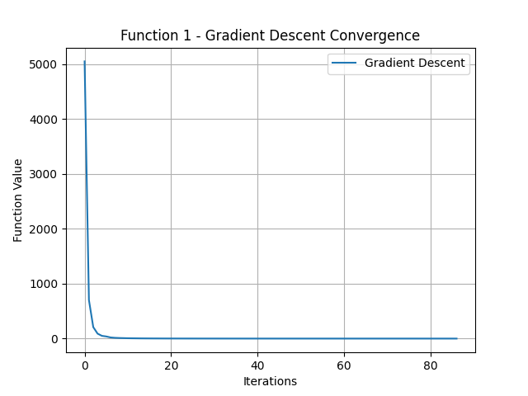
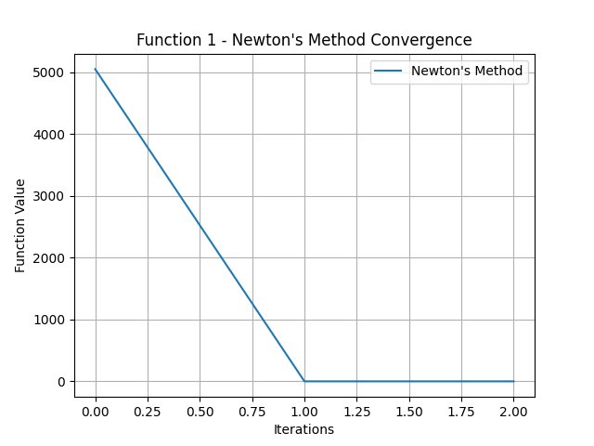
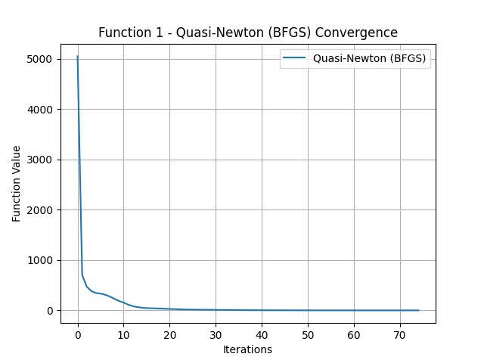
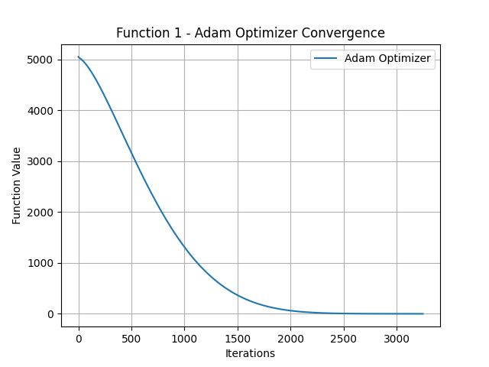

Slide 4
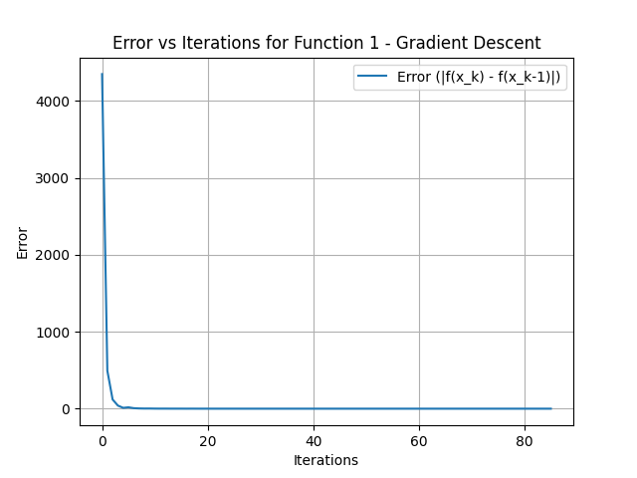
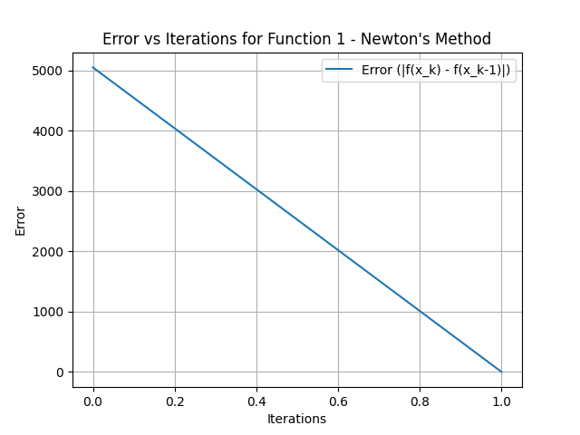
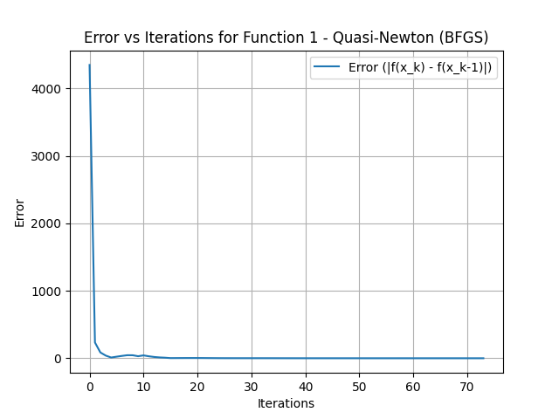
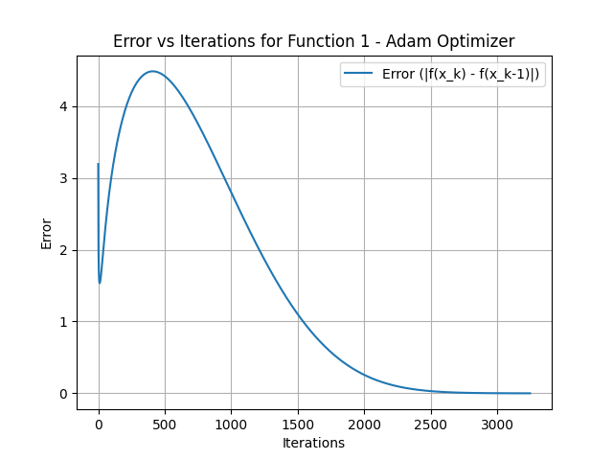

Slide 5
Function 2: Log Barrier Function
Gradient Descent
Steps: 869, Minimum f(x): -2432.5626706206995
Newton’s Method
Steps: 8, Minimum f(x): -2432.866326777652
Quasi-Newton (BFGS)
Steps: 112, Minimum f(x): -2432.861446480478
Adam Optimizer
Steps: 8000, Minimum f(x): -2431.104760050882

Slide 6
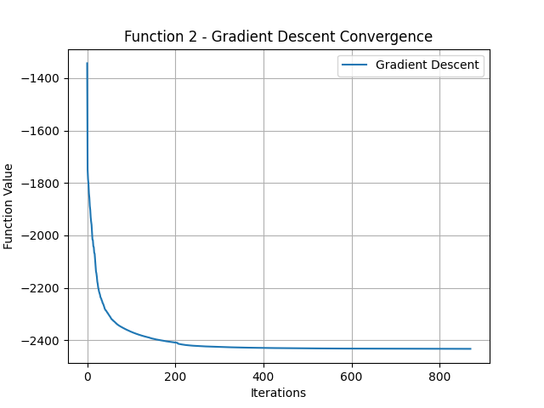
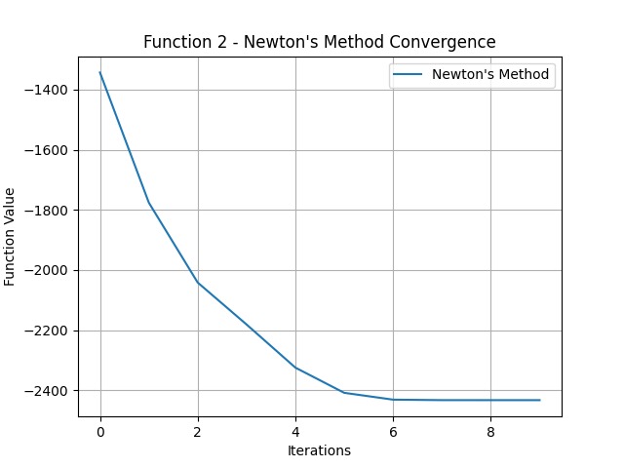
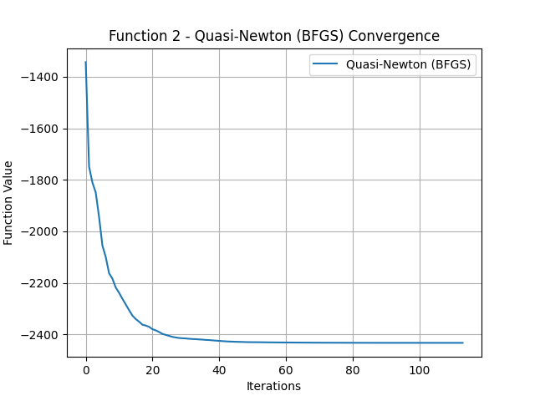
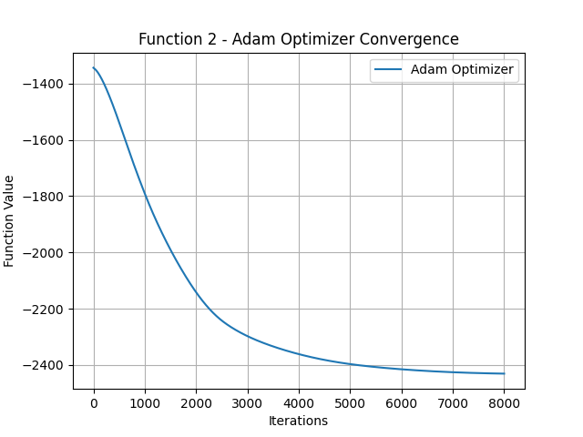

Slide 7
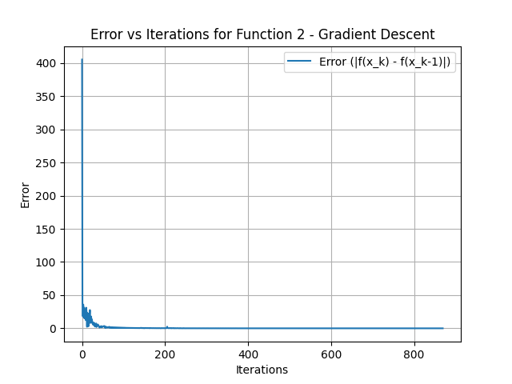
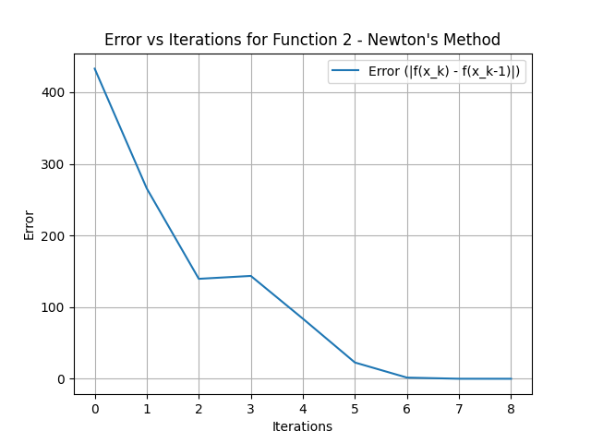
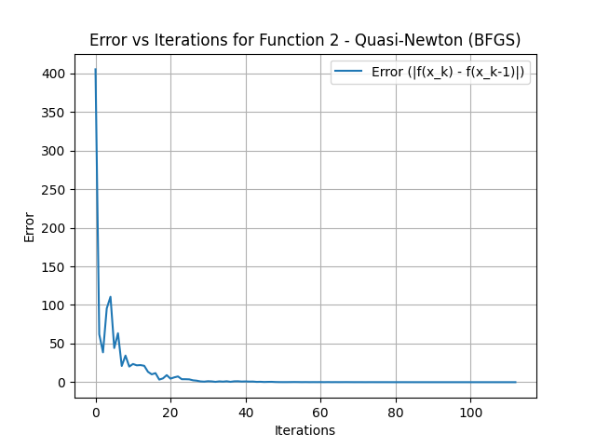
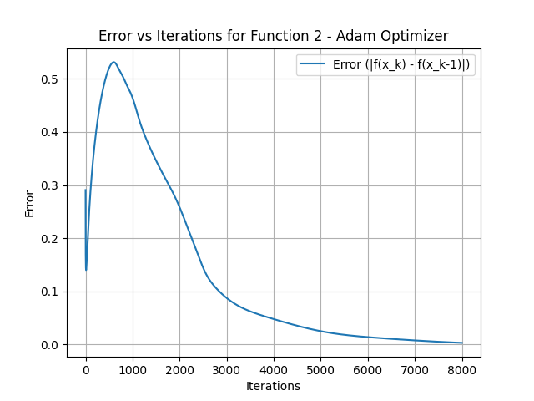

Slide 8
Function 3: Bi-quadratic (Rosenbrock) Function
Gradient Descent
Steps: 3, Minimum f(x): 0.1997655255915457
Newton’s Method
Steps: 10, Minimum f(x): 0.0005784005843096896
Quasi-Newton (BFGS)
Steps: 5, Minimum f(x): 0.053686336330168706
Adam Optimizer
Steps: 1474, Minimum f(x): 0.7850856229011988

Slide 9
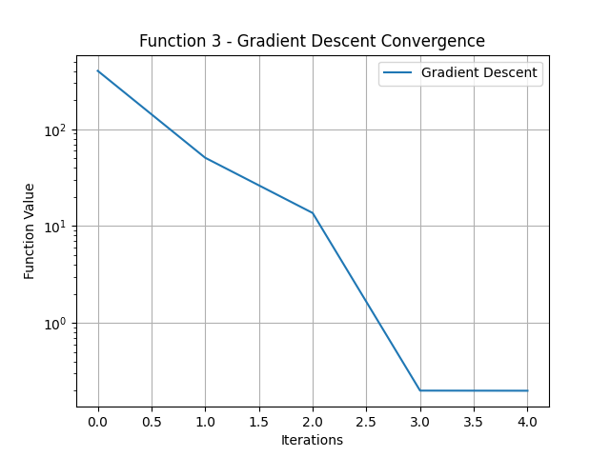
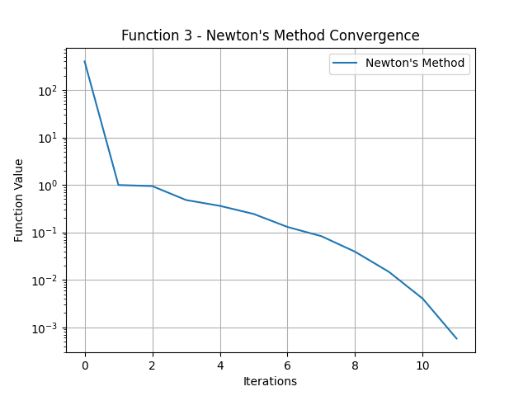
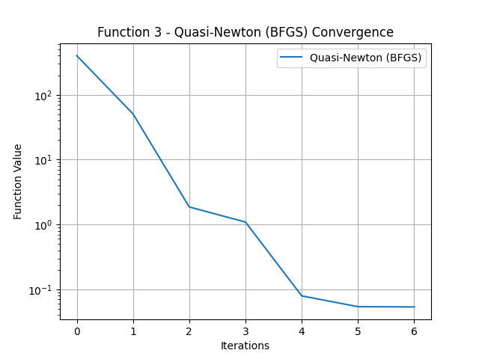
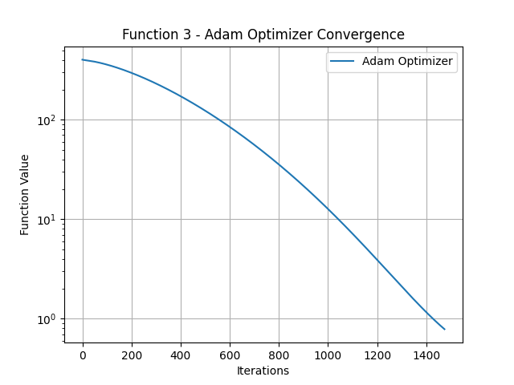

Slide 10
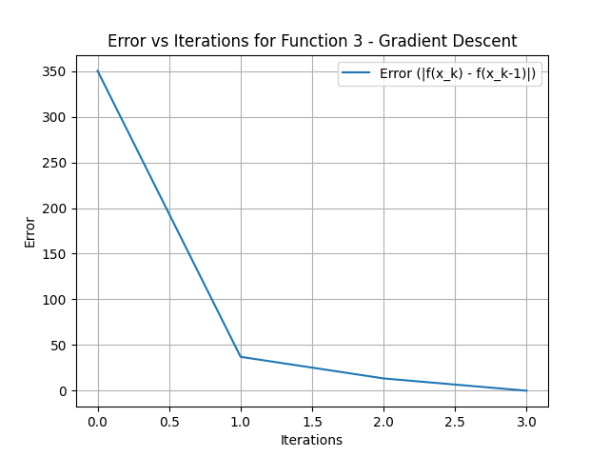
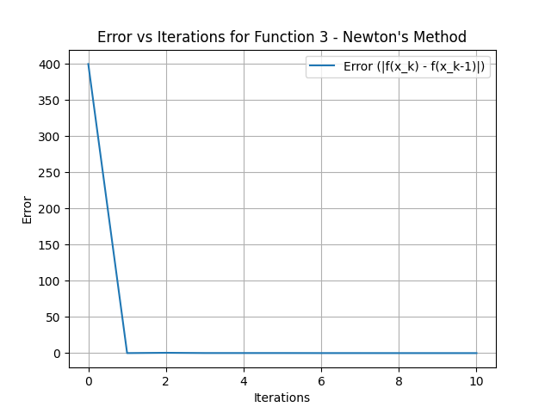
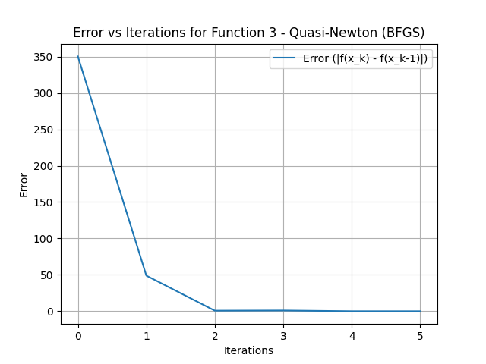
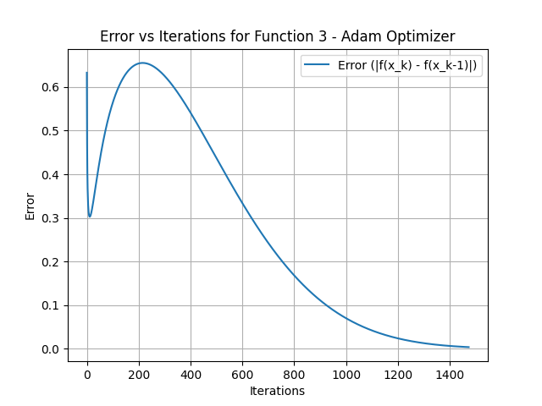

Slide 11
Thank You

